Slide 1
Economic Outlook: Germany
By: Jason Kauffeldt

Slide 2
Table of Contents
3-4……….National Income
5-6……….Labour Market Conditions
7-8……….Price Level and Inflation
9-10……..Money and Interest Rates
11………...References

Slide 3
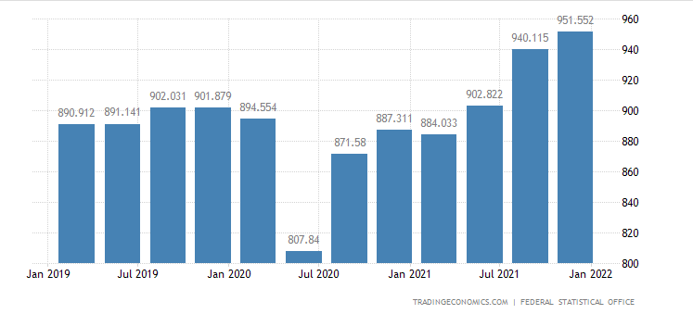
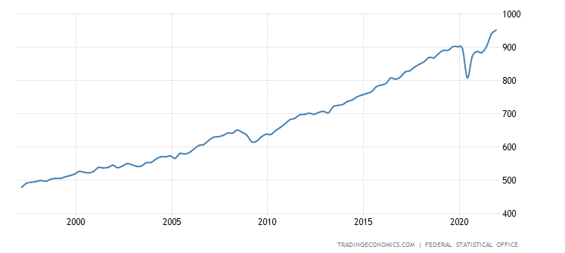
National Income
What is Gross National Income:
The total amount of money earned by people and businesses in a country or region (Investopedia, 2022).
Current Gross National Income:
951.55 billion EUR ( 1.048 trillion USD)
USA National Income:
21.286 trillion USD (21x bigger than GER
Source: Bundesbank https://www.bundesbank.de/en/statistics/money-and-capital-markets/interest-rates-and-yields

Slide 4
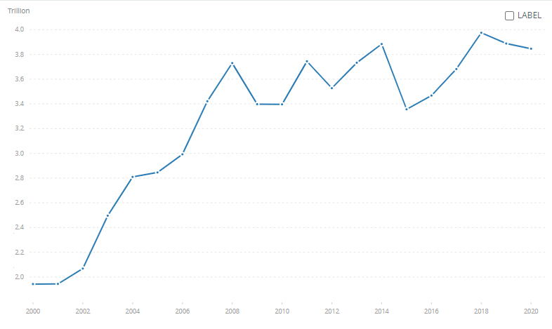
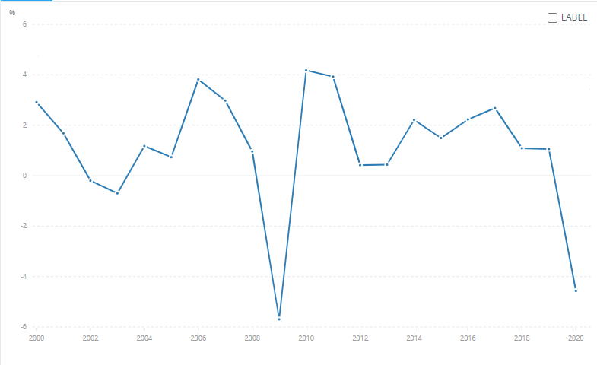
GDP (2020)
Current GDP: 3.946 trillion USD
(compared to 20.94 trillion USD in America)
% Change in GDP: -4.57 %
Source: The World Bank https://data.worldbank.org/indicator/NY.GDP.MKTP.KD.ZG?end=2020&locations=DE&start=2000&view=chart

Slide 5
Labour Market Conditions
Size of labour market
Number of citizens who are employed in Germany
45, 311 as of January 2021 (Bundesbank, 2o22)
Unemployment Status Qualifications
Searching for work of at least 15 hours/week
Registered with unemployment program
Reside in Federal Republic of Germany
Between ages 15-74

Slide 6
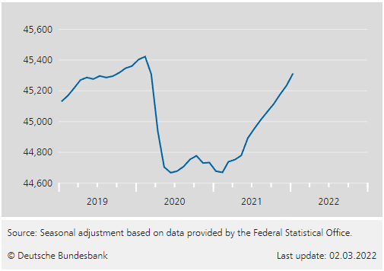
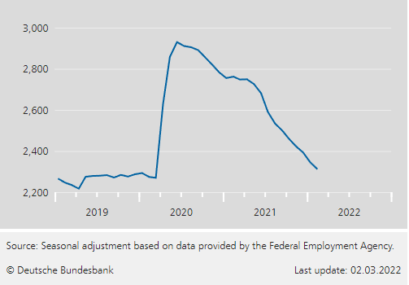
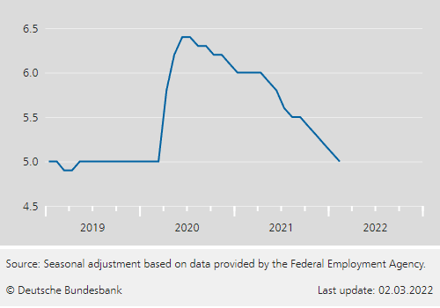
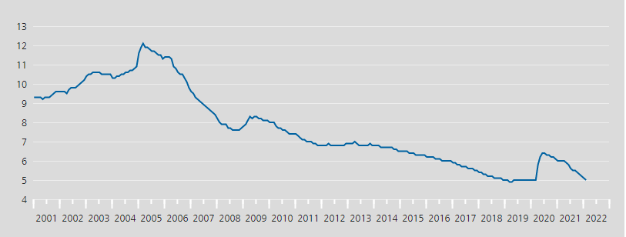
Current employed: 45.311 million
Current unemployed: 2.312 million
Current unemployment rate: 5%
Source: Bundesbank: https://www.bundesbank.de/en/statistics/economic-activity-and-prices/employment-and-labour-market

Slide 7
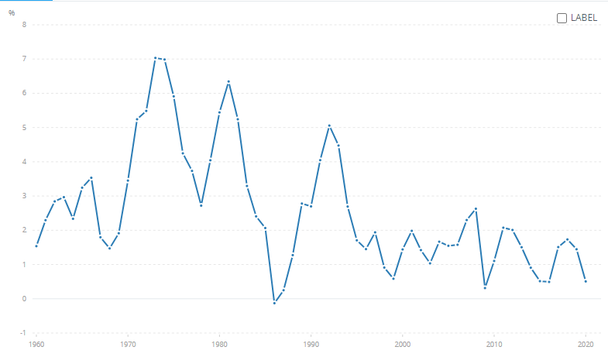
CPI and Inflation
CPI measures the price of goods and services over time
Increases in CPI indicate a rise in prices, whereas decreases indicate a fall in prices
Over the last 20 years, there has been a steady cycle of CPI levels in between 2.6 and .3
Current CPI is set at .507, almost a full point down from 2021 (1.446)
Source: World Bank https://data.worldbank.org/indicator/FP.CPI.TOTL.ZG?end=2020&locations=DE&start=1960

Slide 8
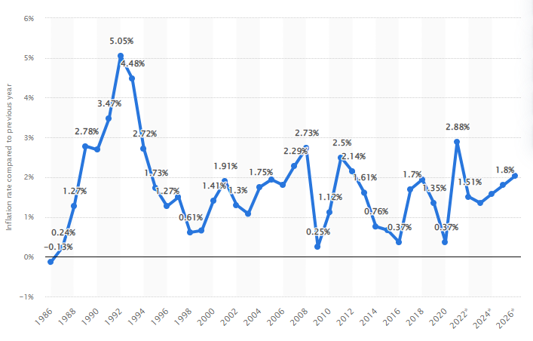
Inflation rate has been increasing constantly over the last few years
In 2019 the inflation rate was 1.37% and decreased to 0.37 in 2020
The ideal inflation rate for Germany is below, but close to 2% (European Central bank)
Inflation cycles through periods of growth and recession, but is generally stable
Source: Statistica https://www.statista.com/statistics/375207/inflation-rate-in-germany/

Slide 9
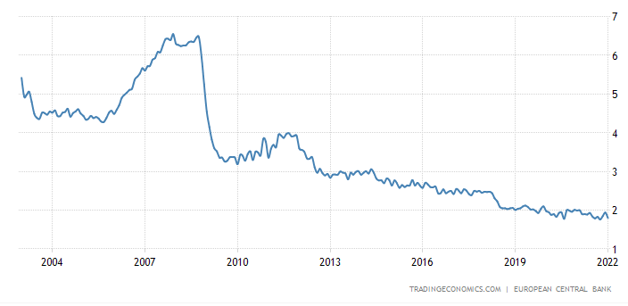
Money and Interest Rates
Bank lending rates are set by the European Central Bank
Lending rate is the average amount of interest that banks charge on their loans (Trading Economics, 2022)
The lending rate seems to go higher in times of crisis and drop in times of security
Current interest rate: 1.9%
Source: Trading Economics https://tradingeconomics.com/germany/bank-lending-rate

Slide 10
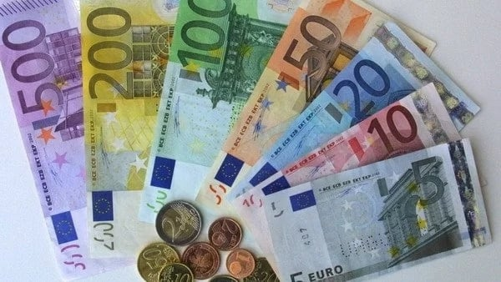
Germany uses the Euro as their national currency (started in 2002)
Euro bills: 5, 10, 20, 50, 100, 200, 500
Euro coins: 1 and 2 euros, 1, 2, 5, 10, 20, 50 cent
One of the strongest currencies in the world, resembling economic strength
Benefits include cheaper imports and low inflation
1 Euro = 1.10 USD
Source: Legit https://www.legit.ng/1127124-what-currency-germany.html

Slide 11
References
Deutsche Bundesbank. (2022). Investment companies. Investment companies | Deutsche Bundesbank. Retrieved March 23, 2022, from https://www.bundesbank.de/en/statistics/banks-and-other-financial-corporations/investment-companies
FRED Economic Data. (2021, December 21). Gross National Income for united states. FRED. Retrieved March 23, 2022, from https://fred.stlouisfed.org/series/MKTGNIUSA646NWDB
Koptyug, E. (2022, March 22). Unemployment rate in Germany 2022. Statista. Retrieved March 23, 2022, from https://www.statista.com/statistics/227005/unemployment-rate-in-germany/
Odhiambo, H. (2019, September 1). Top facts to know about the most expensive currency 2019 and the weakest one. Legit.ng - Nigeria news. Retrieved March 23, 2022, from https://www.legit.ng/1250294-most-expensive-currency-2019.html
O'Neill, A. (2021, October 27). Germany - inflation rate 2026. Statista. Retrieved March 23, 2022, from https://www.statista.com/statistics/375207/inflation-rate-in-germany/
Team, T. I. (2022, February 8). Gross National Income (GNI). Investopedia. Retrieved March 23, 2022, from https://www.investopedia.com/terms/g/gross-national-income-gni.asp
Trading Economics. (2022). Germany bank lending RateFebruary 2022 data - 2003-2021 historical - march forecast. Germany Bank Lending Rate - February 2022 Data - 2003-2021 Historical - March Forecast. Retrieved March 23, 2022, from https://tradingeconomics.com/germany/bank-lending-rate
Trading Economics. (2022). Germany Gross National INCOME2021 data - 2022 forecast - 1991-2020 historical. Germany Gross National Income - 2021 Data - 2022 Forecast - 1991-2020 Historical. Retrieved March 23, 2022, from https://tradingeconomics.com/germany/gross-national-product
Word Bank Group. (2022). GDP (current US$) - germany. Data. Retrieved March 23, 2022, from https://data.worldbank.org/indicator/NY.GDP.MKTP.CD?end=2020&locations=DE&start=2000

